Slide 1
HW2 10/10/2019
Shaojie Carter Zhang
szhang286@fordham.edu

Slide 2
Problem
Use the sample that you generated for training on HW1 (430 observations)
We have a predictor variable Industry taking values 1,2,3,4,5,6,7,8,9,10,11,12 (variable Industry in our example).
Calculate the value of the Gini criterion for each possible split of this variable.
The possible split values are 1.5, 2.5, 3.5,…,11.5
For each of those split values calculate the value of the Gini Diversity index (gdi) and write a report, including the matlab code and your observations

Slide 3
Gini criterion
for each of two branches in the split: Calculate percent branch represents
Calculate probability of class in the given branch.
Square the class probability.
Sum the squared class probabilities.
Subtract the sum from 1.
Weight each branch based on the baseline probability. Sum the weighted gini index for the split.

Slide 4
Example:
For a split criterion 1.5:
Suppose that among the 430 observations in the sample, 100 have the value of Industry <1.5 (i.e. Industry=1) and the remaining 330 have Industry> 1.5 (i.e. 2,3,…12).
Therefore, the weight of the first branch (Industry=1) w1=(100/430) and for the second branch (Industry=2,3,4..12) w2=(330/430).
Suppose that in the first branch there are 70 observations of class 1 and 30 of class -1. For the second branch there are 230 observations of class 1 and 100 observations of class -1.
G1=1 – (70/100)^2-(30/100)^2
G2=1 – (230/330)^2-(100/330)^2
The value of the Gini criterion for this split:
GC(1.5)=G1*w1+G2*w2

Slide 5
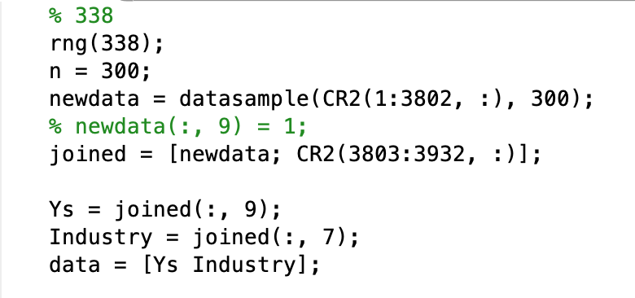
Matlab code
First import CR2, and construct data:

Slide 6
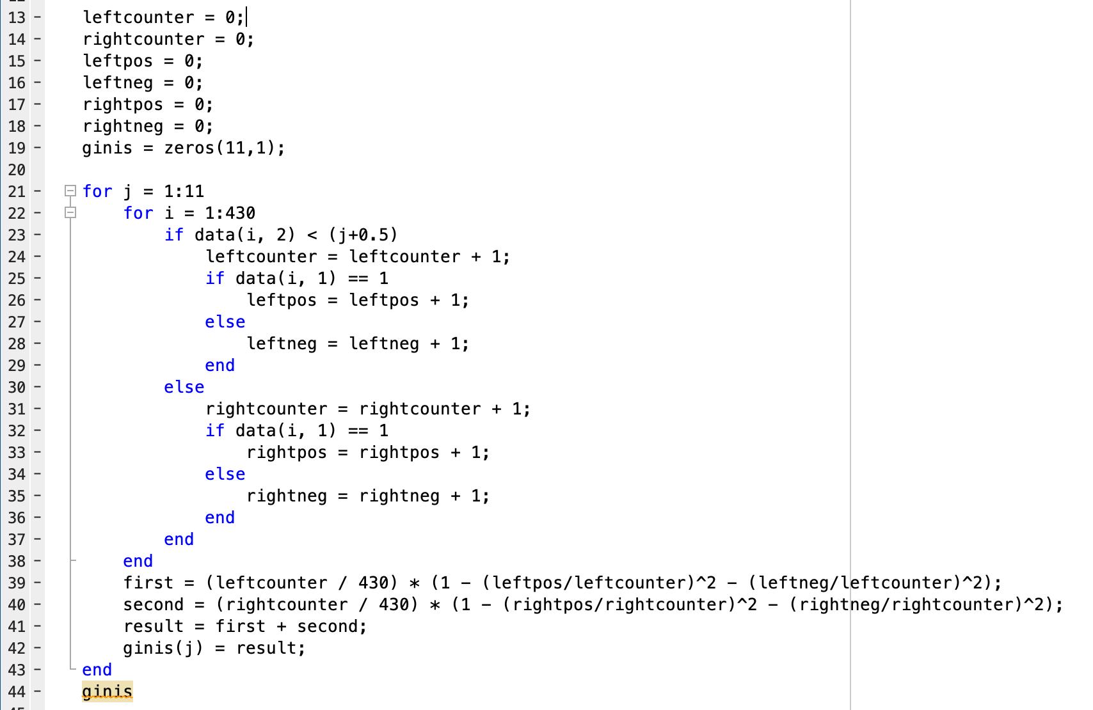
Code body

Slide 7
Output
ginis =
0.4217
0.8432
1.2655
1.6874
2.1092
2.5311
2.9529
3.3747
3.7966
4.2185
4.6403
As we can see, the gini indexes increase as the split value increase.
So as the split value increases, the impurity of our tree increases.
So it would be better to use a small split value for here.

